Slide 1
Decision Tree and Random Forest
Saleena T.S
Research Associate
ICFOSS, Trivandrum

Slide 2
Agenda
What is classification?
What is Decision tree?
Visualizing decision tree
Terminologies associated with decision tree
Random Forest algorithm
Visualising Random Forest
Hands-on session

Slide 3
Decision tree
Graphical representation of all possible solution to a decision
From the root it keeps on branching based on the number of decisions
Root node, leaf node, branches/sub nodes
Select the appropriate feature for branching

Slide 4
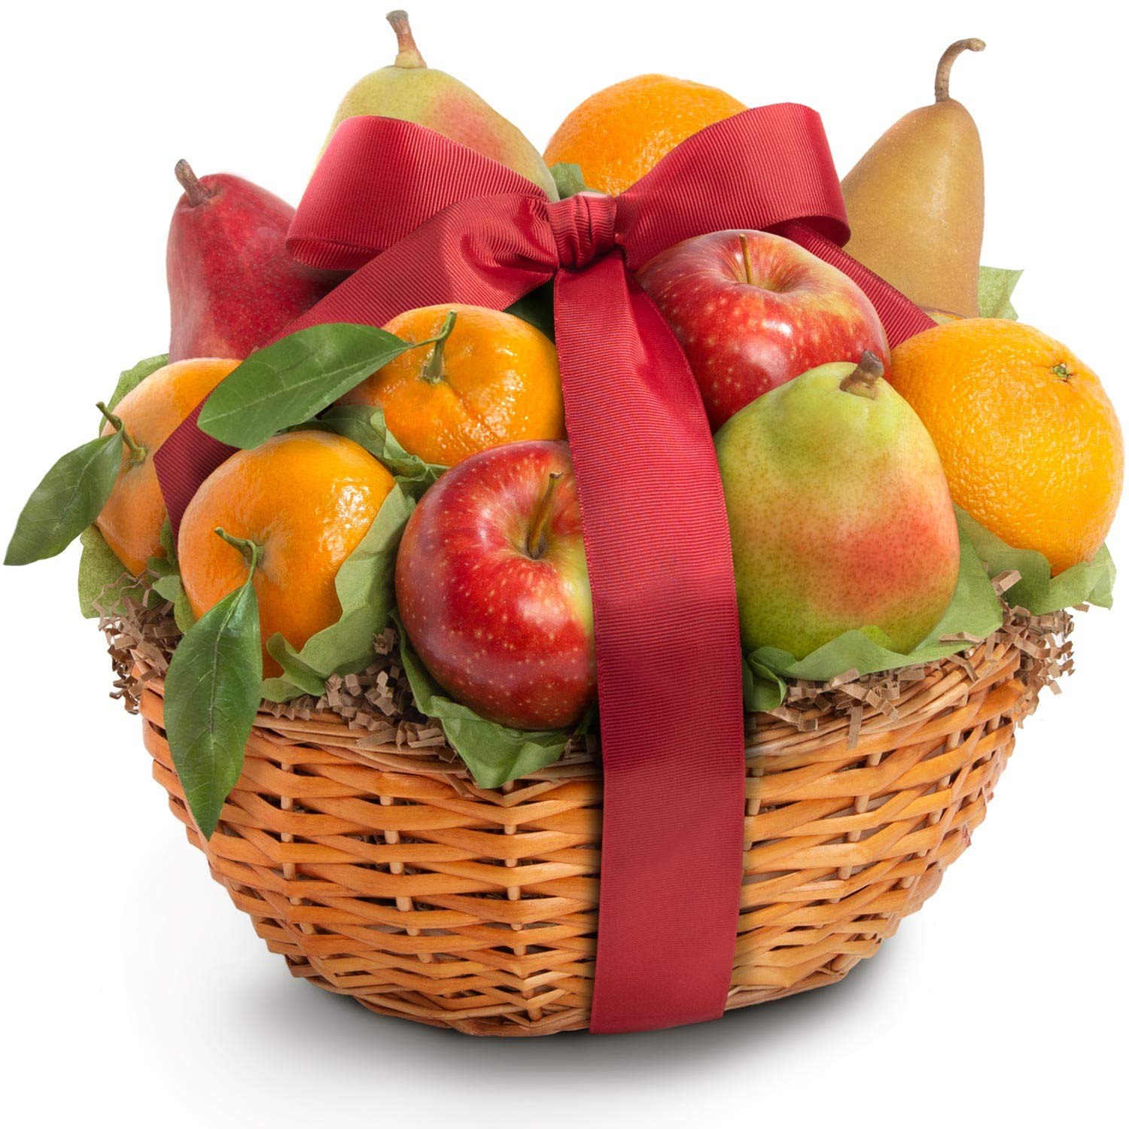

Slide 5
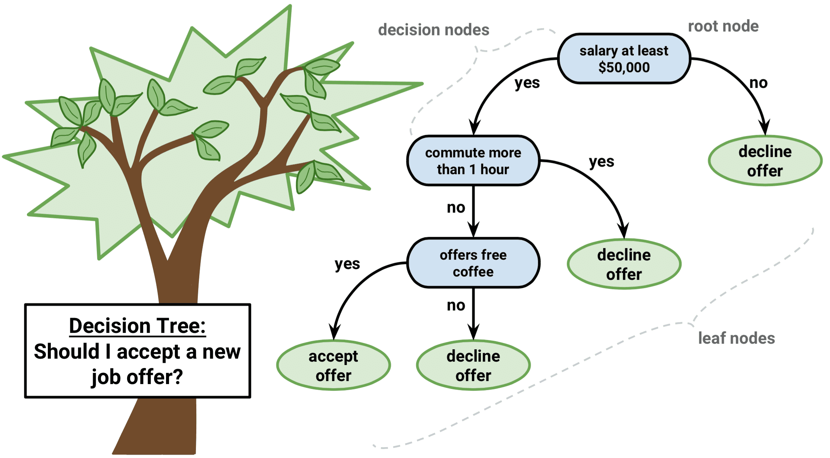
Visualization of DT

Slide 6
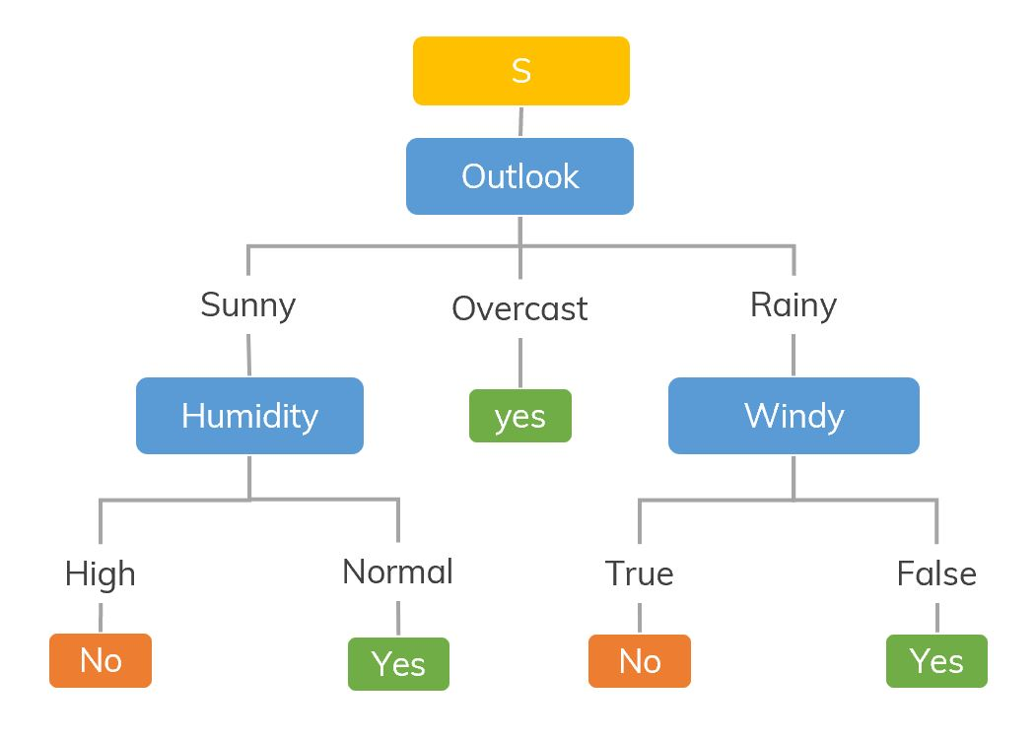

Slide 7
Terminologies
Entropy : Measure of impurity or randomness
Information gain: Measures reduction in entropy. Decides which feature should be selected as decision node.
Pruning: cutting down the nodes to get the optimal solution

Slide 8
Entropy
Entropy(s)= -P(yes)log2 P(yes)- P(no) log2 P(no) Where,
S= Total number of samples
P(yes)= probability of yes
P(no)= probability of no

Slide 9
Information gain
It calculates how much information a feature provides us about a class.
According to the value of information gain,split the node and build the decision tree.
A node/attribute having the highest information gain is split first.
Information Gain= Entropy(S)- [(Weighted Avg) *Entropy(each feature)]

Slide 10
Pruning
Pruning is a process of deleting the unnecessary nodes from a tree in order to get the optimal decision tree.
A too-large tree increases the risk of overfitting
Small tree may not capture all the important features of the dataset.
Therefore, a technique that decreases the size of the learning tree without reducing accuracy is known as Pruning.

Slide 11
Algorithm
Step-1: Begin the tree with the root node, says S, which contains the complete dataset.
Step-2: Find the best attribute in the dataset using Attribute Selection Measure (ASM).
Step-3: Divide the S into subsets that contains possible values for the best attributes.
Step-4: Generate the decision tree node, which contains the best attribute.
Step-5: Recursively make new decision trees using the subsets of the dataset created in step -3. Continue this process until a stage is reached where you cannot further classify the nodes and called the final node as a leaf node.

Slide 12
Advantages
Simple to understand -follows the same process which a human follow while making any decision in real-life.
It can be very useful for solving decision-related problems.
It helps to think about all the possible outcomes for a problem.
There is less requirement of data cleaning compared to other algorithms.

Slide 13
Disadvantages
The decision tree contains lots of layers, which makes it complex.
It may have an overfitting issue, which can be resolved using the Random Forest algorithm.
For more class labels, the computational complexity of the decision tree may increase.

Slide 14
Random Forest
Builds multiple decision trees and merges them together to get the final output
It is training on the principle of “bagging”
Learning through multiple models and combining the results to get more stable prediction.
Hyper parameter will be the number of decision trees used.

Slide 15
Why Random Forest?
Less training time
Use of multiple trees reduces the chance for overfitting
For large data it produce high accuracy predictions
It can handle high quantity of missing data

Slide 16
RF Algorithm
Create subdatasets of total population with batch of random data
Create decision tree for each subdataset
Each tree will have their own result
Get majority vote from the entire trees as final result

Slide 17
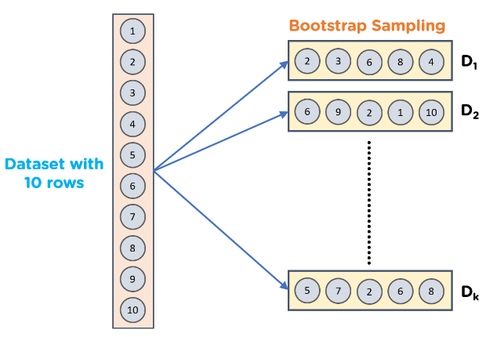
Bootstrapping

Slide 18
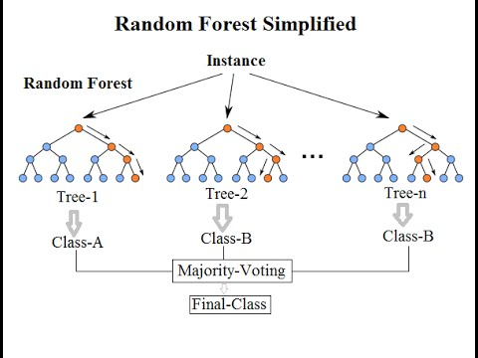

Slide 19
Ensemble method
Multiple individual models are combined to produce an effective optimal prediction model.
In RF classifier, the output will be the majority votes of the decision trees
In RF regressor it will be the mean or median of the output of decision trees.

Slide 20
Applications
Remote sensing
Gaming
Multiple class object detection

